Slide 1

Business Athletics
Timon Clauß, Alexandra Däs, Marcel Dittrich, Lukas Ziegler

Slide 2
Agenda
Evaluation
Why us?
Importance of Training
User Interface
Outlook

Slide 3
Importance of Training
Evaluation
Agenda
Outlook
User Interface
Why us?

Slide 4

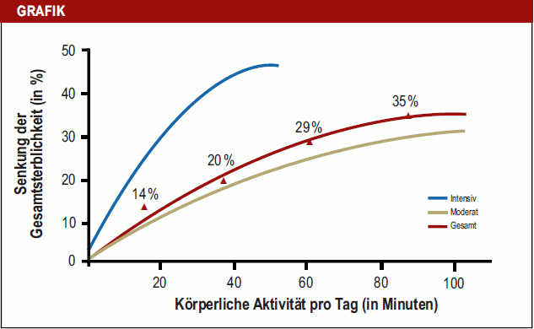
Importance of Training
„New Year new Goals!“
Positve effect of training more
Healthy goals
Getting more in shape
Getting bigger
Stay active
Perfect for
Fitness studios
Professional Athletes
Sports Clubs
Beginners

Slide 5

10 Reasons to Track your Training
You train with a plan and therefore more effectively
You can fully concentrate on your training
You do not rest on a fake progression
You hurt yourself less often
You find out the best training time for you
You are less likely to be disappointed
You can see if you are improving or stagnating, you can quickly figure out what you need to do to improve
You train harder
You can train according to complex progression
You don't train in the "wrong" rep ranges
Perfect for
Fitness studios
Professional Athletes
Sports Clubs
Beginners
Importance of Training
„New Year new Goals!“
Positve effect of training more
Healthy goals
Getting more in shape
Getting bigger
Stay active
https://www.aerzteblatt.de/archiv/209444/Sport-als-Praevention-Fakten-und-Zahlen-fuer-das-individuelle-Mass-an-Bewegung
https://www.aerzteblatt.de/archiv/209444/Sport-als-Praevention-Fakten-und-Zahlen-fuer-das-individuelle-Mass-an-Bewegung

Slide 6
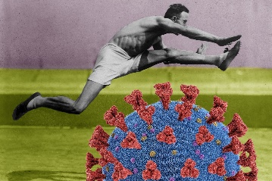
10 Reasons to Track your Training
You train with a plan and therefore more effectively
You can fully concentrate on your training
You do not rest on a fake progression
You hurt yourself less often
You find out the best training time for you
You are less likely to be disappointed
You can see if you are improving or stagnating, you can quickly figure out what you need to do to improve
You train harder
You can train according to complex progression
You don't train in the "wrong" rep ranges
Perfect for
Fitness studios
Professional Athletes
Sports Clubs
Beginners
Importance of Training
„New Year new Goals!“
Positve effect of training more
Healthy goals
Getting more in shape
Getting bigger
Stay active
https://www.aerzteblatt.de/archiv/209444/Sport-als-Praevention-Fakten-und-Zahlen-fuer-das-individuelle-Mass-an-Bewegung
Origin
Origin:
At the highesttimes of Corona people were in the quarantine, hence they could only trainat home.
Therefore, we created anApp to track our training much easier and faster
Start 2020
Our Team
Alexandra
Marcel
Timon
Lukas
Notes:
Ihr trainiert mit Plan und somit effektiver
Ihr könnt Euch voll und ganz aufs Training konzentrieren
Ihr ruht Euch nicht auf einer Fakeprogression aus
Ihr verletzt Euch seltener
Ihr findet die für Euch beste Trainingszeit heraus
Ihr seid seltener enttäuscht
Ihr seht, ob Ihr Euch verbessert und wenn Ihr Euch nicht verbessert, könnt Ihr schnell herausfinden, was Ihr machen müsst, um Euch zu verbessern.
Ihr trainiert nicht in “falschen” Wdh-Bereichen
Ihr trainiert härter
Ihr könnt nach komplexen Progressionsmodellen trainieren
You train with a plan and therefore more effectively
You can fully concentrate on your training
You do not rest on a fake progression
You hurt yourself less often
You find out the best training time for you
You are less likely to be disappointed
You can see if you are improving and if you are not improving, you can quickly figure out what you need to do to improve.Y
ou don't train in the "wrong" rep ranges
You train harder
You can train according to complex progression models

Slide 7
10 Reasons to Track your Training
You train with a plan and therefore more effectively
You can fully concentrate on your training
You do not rest on a fake progression
You hurt yourself less often
You find out the best training time for you
You are less likely to be disappointed
You can see if you are improving or stagnating, you can quickly figure out what you need to do to improve
You train harder
You can train according to complex progression
You don't train in the "wrong" rep ranges
https://www.aerzteblatt.de/archiv/209444/Sport-als-Praevention-Fakten-und-Zahlen-fuer-das-individuelle-Mass-an-Bewegung
Origin
Origin:
At the highest times of Corona people were in the quarantine, hence they could only train at home.
Therefore, we created an App to track our training much easier and faster
Origin:
At the highesttimes of Corona people were in the quarantine, hence they could only trainat home.
Therefore, we created anApp to track our training much easier and faster
Start 2020
Our Team
Alexandra
Marcel
Timon
Lukas

Slide 8
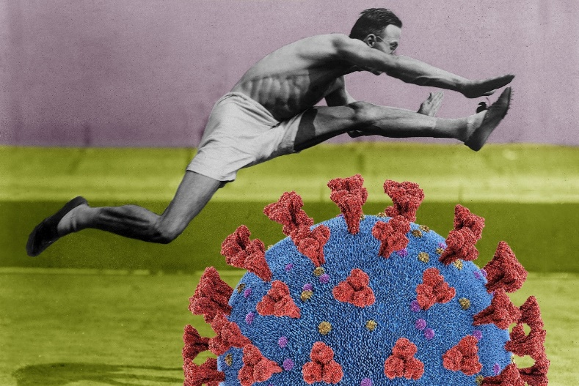
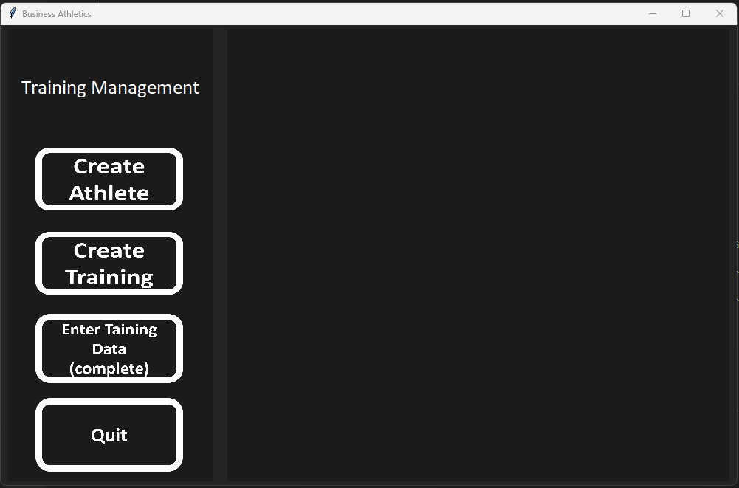
Start 2020
Our Team
Alexandra
Marcel
Timon
Lukas
Origin:
At the highest times of Corona people were in the quarantine, hence they could only train at home.
Therefore, we created an App to track our training much easier and faster
Origin
https://www.aerzteblatt.de/archiv/209444/Sport-als-Praevention-Fakten-und-Zahlen-fuer-das-individuelle-Mass-an-Bewegung
https://www.gq-magazin.de/body-care/artikel/sport-waehrend-corona-gefahr-fuer-das-immunsystem
https://trends.google.com/trends/explore?date=2022-01-01%202022-12-31&q=fitnessstudio
GUI DEMO

Slide 9
Evaluation of trainings:
Start 2020
Our Team
Alexandra
Marcel
Timon
Lukas
Origin:
At the highesttimes of Corona people were in the quarantine, hence they could only trainat home.
Therefore, we created anApp to track our training much easier and faster
Origin:
At the highest times of Corona people were in the quarantine, hence they could only train at home.
Therefore, we created an App to track our training much easier and faster
Origin
GUI DEMO
R-Studio
Athlete evaluation:
Get a detailed overview of all your training data
Get the average duration of training across all training programs or for a specific training
Coach Evaluation:
Get the average duration, median and standard deviation of a certain training over all athletes

Slide 10
Evaluation of trainings:
GUI DEMO
Athlete evaluation:
Get a detailed overview of all your training data
Get the average duration across all training programs or for a specific training
Coach evaluation:
Get the average duration, median and standard deviation of:
a certain training
across all training programs
Evaluation of trainings
over all athletes or a certain athlete

Slide 11
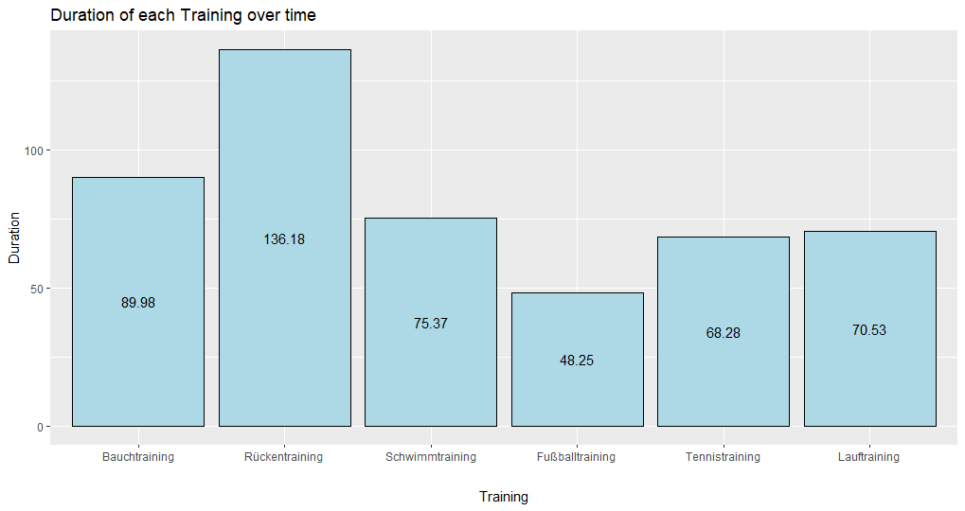
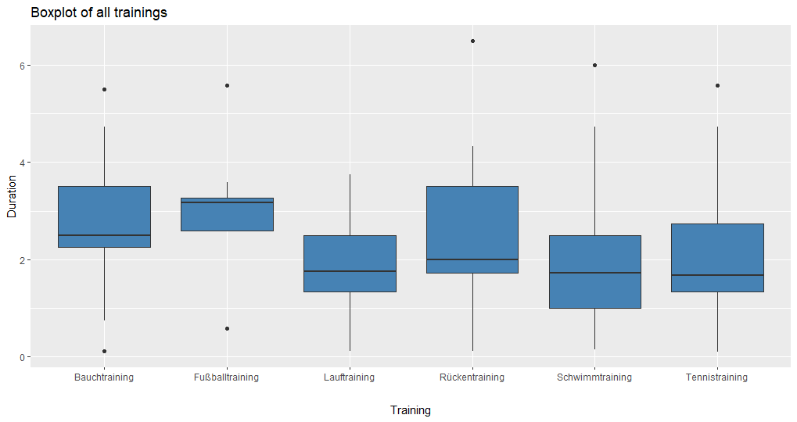
Evaluation of trainings:
GUI DEMO
Get a compact overview from the total duration of each training
Evaluation of trainings

Slide 12
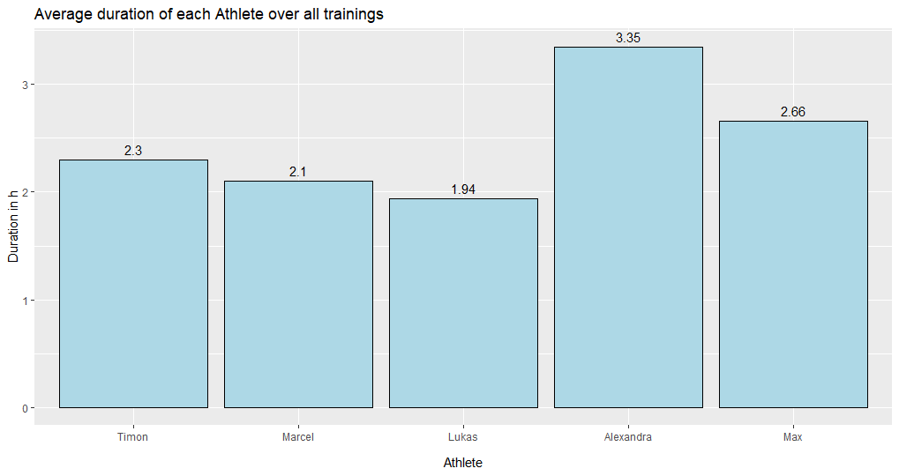
Evaluation of trainings:
GUI DEMO
Get a compact overview of the average training durations of all athletes
Evaluation of trainings
Athlete evaluation:
Get a detailed overview of all your training data
Get the average duration of training across all training programs or for a specific training
Coach Evaluation:
Get the average duration, median and standard deviation of a certain training over all athletes
Why us?!
Valuable insights into your trainings
Collaboration with scientists:
- Implementation of newest research
- Scientific analysis of data
Unique features e.g., training schedule
Our program:
- Trainings schedule → Easy and fast change for the next week
- Including age → To calculate calorie burn
Our team:
- Young
- Dynamic
- Fast
- Diverse
- Constantly advancing
Portfolio:
- Famous athletes
- Famous clubs
- Famous fitness studios
- 100.000+ beginners

Slide 13
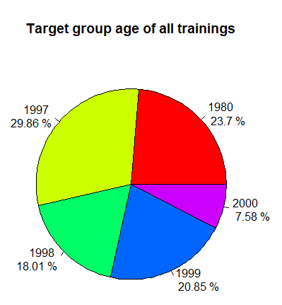
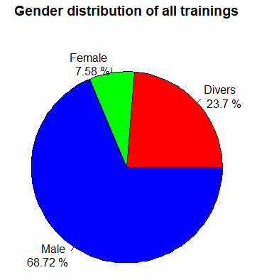
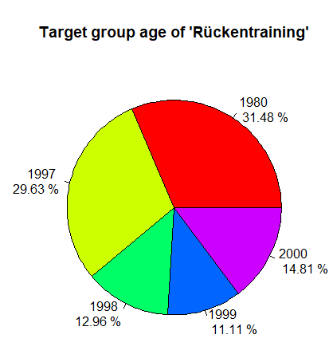
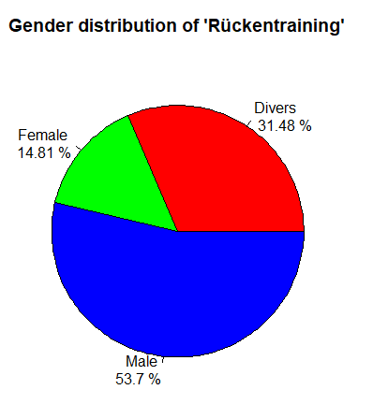
Features in the evaluation of trainings:
GUI DEMO
Analysis of all trainings:
Evaluation of trainings
Analysis of specific trainings:
Athlete evaluation:
Get a detailed overview of all your training data
Get the average duration of training across all training programs or for a specific training
Coach Evaluation:
Get the average duration, median and standard deviation of a certain training over all athletes
Why us?!
Valuable insights into your trainings
Collaboration with scientists:
- Implementation of newest research
- Scientific analysis of data
Unique features e.g., training schedule
Our program:
- Trainings schedule → Easy and fast change for the next week
- Including age → To calculate calorie burn
Our team:
- Young
- Dynamic
- Fast
- Diverse
- Constantly advancing
Portfolio:
- Famous athletes
- Famous clubs
- Famous fitness studios
- 100.000+ beginners

Slide 14
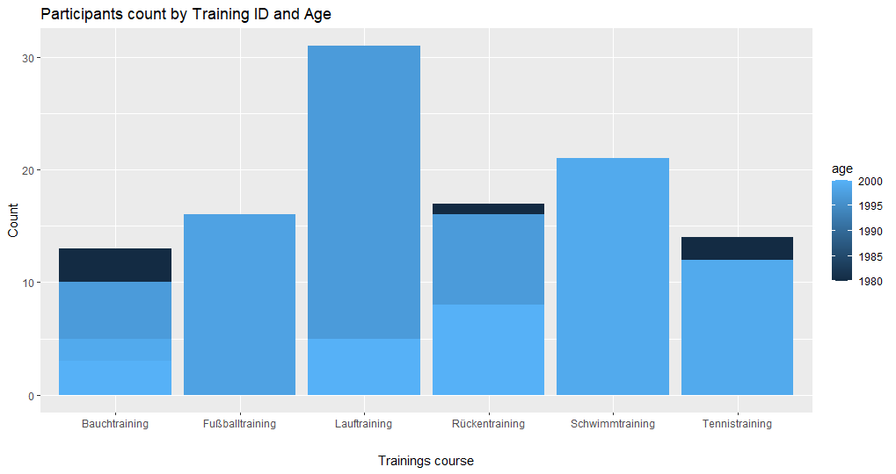
Features in the evaluation of trainings:
GUI DEMO
Bar-chart with number of athletes for each training and the age distribution
Evaluation of trainings
Athlete evaluation:
Get a detailed overview of all your training data
Get the average duration of training across all training programs or for a specific training
Coach Evaluation:
Get the average duration, median and standard deviation of a certain training over all athletes
Why us?!
Valuable insights into your trainings
Collaboration with scientists:
- Implementation of newest research
- Scientific analysis of data
Unique features e.g., training schedule
Our program:
- Trainings schedule → Easy and fast change for the next week
- Including age → To calculate calorie burn
Our team:
- Young
- Dynamic
- Fast
- Diverse
- Constantly advancing
Portfolio:
- Famous athletes
- Famous clubs
- Famous fitness studios
- 100.000+ beginners

Slide 15
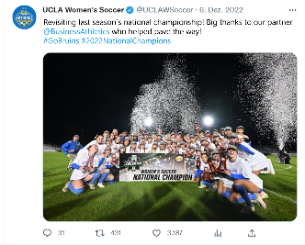

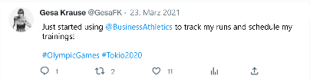
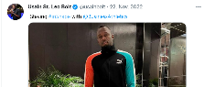
Why us?
Valuable insights into your trainings
Unique features:
- Trainings schedule → Easy and fast change for the next week
- Including age → To calculate calorie burn
Collaboration with scientists:
- Implementation of newest research
- Scientific analysis of data
Unique features e.g., training schedule
Our program:
- Trainings schedule → Easy and fast change for the next week
- Including age → To calculate calorie burn
Our team:
- Young
- Dynamic
- Fast
- Diverse
- Constantly advancing
Portfolio:
- Famous athletes
- Famous clubs
- Famous fitness studios
- 100.000+ beginners
Our team:
- Young
- Diverse
- Dynamic
- Innovative
- Constantly advancing
Social Media

Slide 16
Valuable insights into your trainings
Portfolio:
- Famous athletes
- Famous clubs
- Famous fitness studios
- 100.000+ beginners
Collaboration with scientists:
- Implementation of newest research
- Scientific analysis of data
Why us?
Our team:
- Young
- Diverse
- Dynamic
- Innovative
- Constantly advancing
Unique features:
- Trainings schedule → Easy and fast change for the next week
- Including age → To calculate calorie burn
Social Media

Slide 17
Valuable insights into your trainings
Portfolio:
- Famous athletes
- Famous clubs
- Famous fitness studios
- 100.000+ beginners
Collaboration with scientists:
- Implementation of newest research
- Scientific analysis of data
Why us?!
Our team:
- Young
- Dynamic
- Fast
- Diverse
- Constantly advancing
Our program:
- Trainings schedule → Easy and fast change for the next week
- Including age → To calculate calorie burn
Our team:
- Young
- Diverse
- Dynamic
- Innovative
- Constantly advancing
Why us?
Unique features:
- Trainings schedule → Easy and fast change for the next week
- Including age → To calculate calorie burn
Unique features e.g., training schedule
Social Media

Slide 18

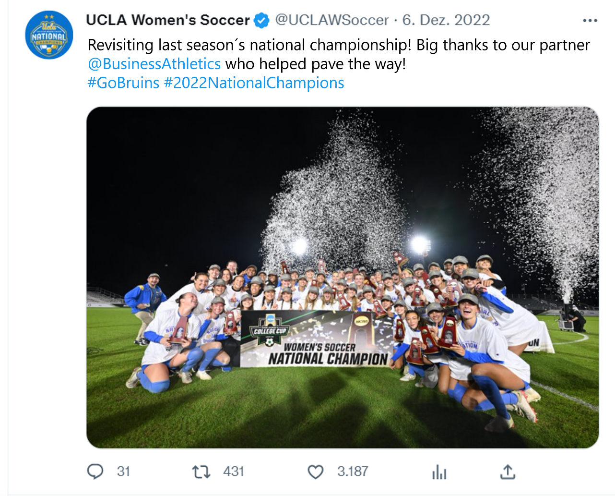

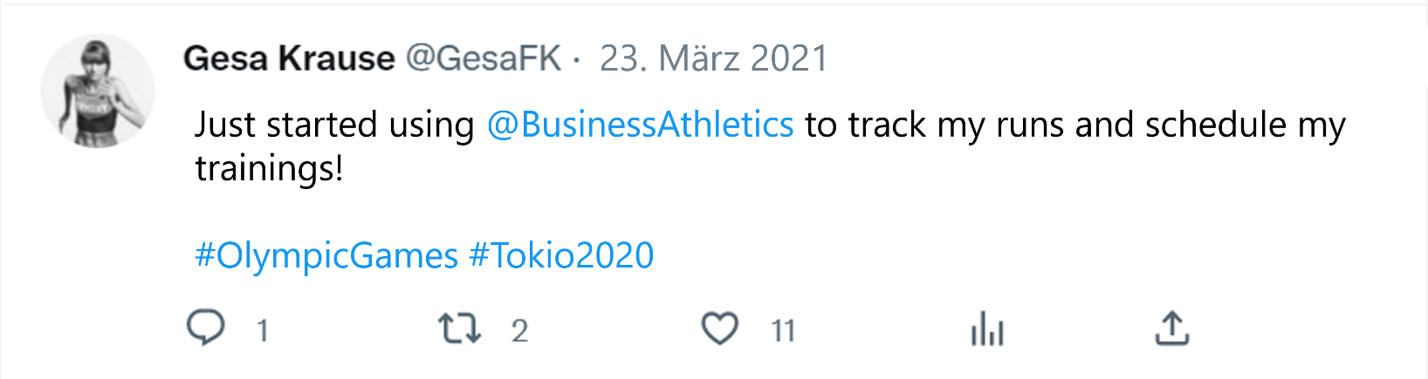
Social Media

Slide 19
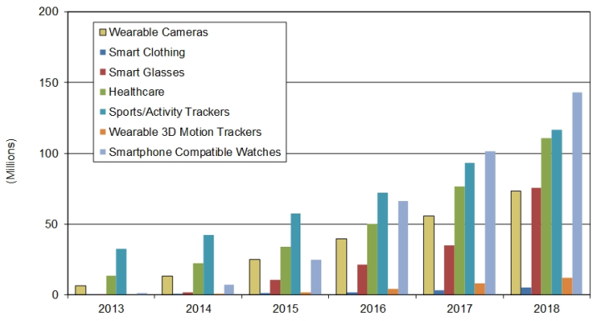
Outlook
More people use electronic wearables. Including sport/active trackers
Our goal for the upcoming year is to get a working app on all electronic trackers which also works with smart clothing
Adding the „Live Coaching“ feature, including videos, tips and tricks to improve your training
Extending the target group analysis

Slide 20
Extending the target group analysis
Outlook
More people use electronic wearables. Including sport/active trackers
Our goal for the upcoming year is to get a working app on all electronic trackers which also works with smart clothing
Adding the „Live Coaching“ feature, including videos, tips and tricks to improve your training
https://www.tecchannel.de/a/wearables-im-profi-einsatz-logistik-sport-und-gesundheitswesen,2051642

Slide 21
Thank you for your attention!
Business Athletics
Timon Clauß, Alexandra Däs, Marcel Dittrich, Lukas Ziegler
“Sport and health are so important to our nation that they deserve to be right at the front of people’s minds.”
— Daley Thompson
https://quotefancy.com/quote/1443499/Daley-Thompson-Sport-and-health-are-so-important-to-our-nation-that-they-deserve-to-be

